Slide 1
Burst Denoising with Kernel Prediction Networks
Pavel Rastopchin
Nati Joseph
Notes:
In this presentation me and Nati will talk about using Convolutional Networks to denoise images. Let’s start.

Slide 2
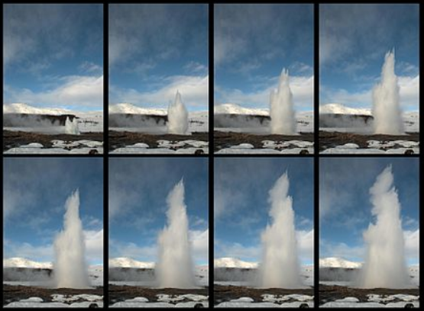
What is Burst Denoising?
Burst mode - multiple shots in a short time.
Burst Denoising – Using the noisy images from the burst to reconstruct the original image.
In this paper Encoder-Decoder architecture is used to denoise a burst.
Notes:
What is burst denoising? As we all know, a burst mode is basically taking many pictures very fast. Low light, moving objects and internal camera noise tend to produce noisy images. But, if we find some smart way to combine all those images from the burst, we can produce an image without a noise or a blur. In this paper they used Encoder-Decoder architecture to complete this task.

Slide 3
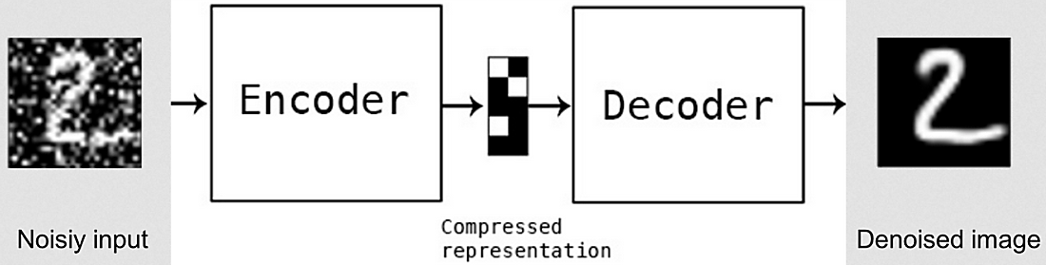
CNN - Convolutional Neural Networks
CNNs can be used to denoise images by learning mappings from noisy images to noiseless images by training on millions of examples.
Notes:
CNN’s or in our case Encoder/Decoder – basically a bunch of convolutional layers stacked together with down-sampling and up-sampling layers. A kind of sorcery called “machine learning” makes the map a noisy image to a noise-less image.

Slide 4
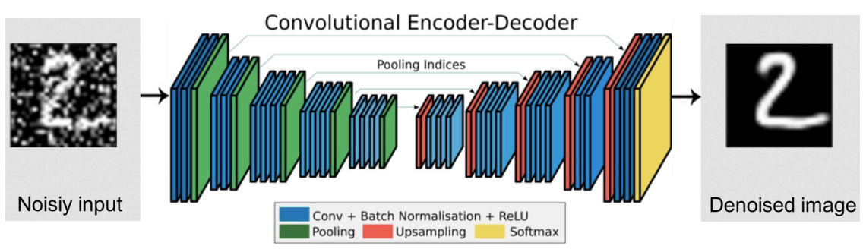
CNN - Convolutional Neural Networks
Again: Learning mappings from noisy images to noiseless images.
In current paper a different approach was used.
Notes:
I’ll say it again – the CNN learns to map a noisy image to a noiseless image. But! In our case they have a different approach.

Slide 5
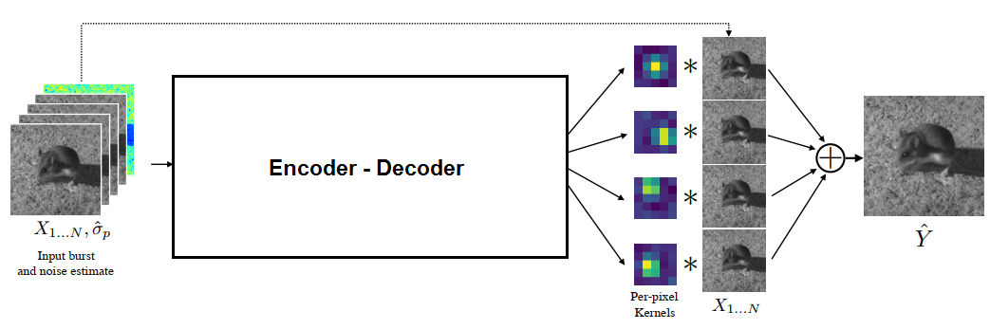
KPN - Kernel Prediction Network
Encoder-Decoder learns a mapping from noisy burst to a filters which denoise the images.
Notes:
Behold the KNP – Kernel Prediction Network. Instead of learning mappings to noiseless images, it learns mappings to denoising kernels. You give it a burst full of noise and blur, and it will give you kernels (or filters) to fix the image. As you can see here, the Encoder/Decoder predicts kernels for each pixel and for each image of the burst, apply them and sums the results together.

Slide 6
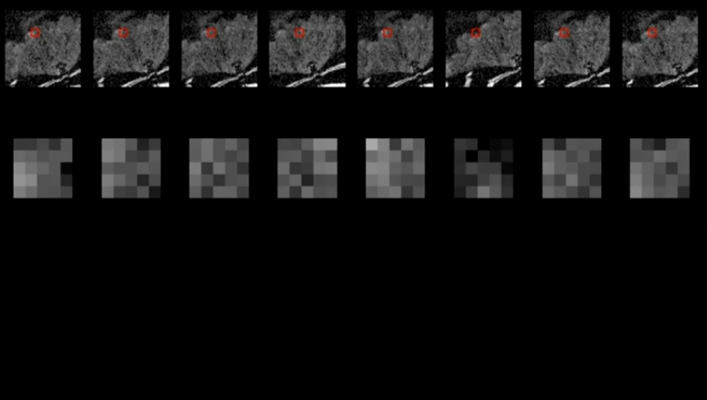
KPN – In details
For a given burst of N images, and kernel size KxK.
N patches of size KxK extracted from the image.
Notes:
I’ll say it again – each denoising kernel is per pixel.
It’s predicted by extracting patches of the same size as the kernel, and feed them in to the network.

Slide 7
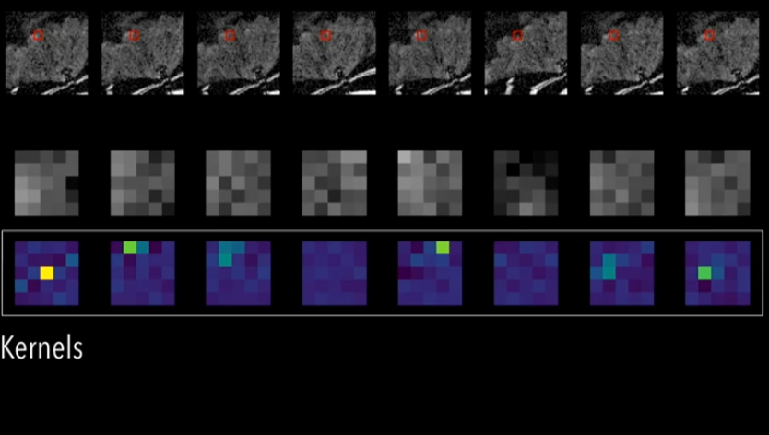
KPN – In details
The first image of the burst is selected as “reference image”.
KPN produces a KxK kernel for each patch.
Notes:
Here we can see the kernel that were predicted for each patch. Buy the way, one of the images, let’s say the first one is selected as “reference image”.

Slide 8
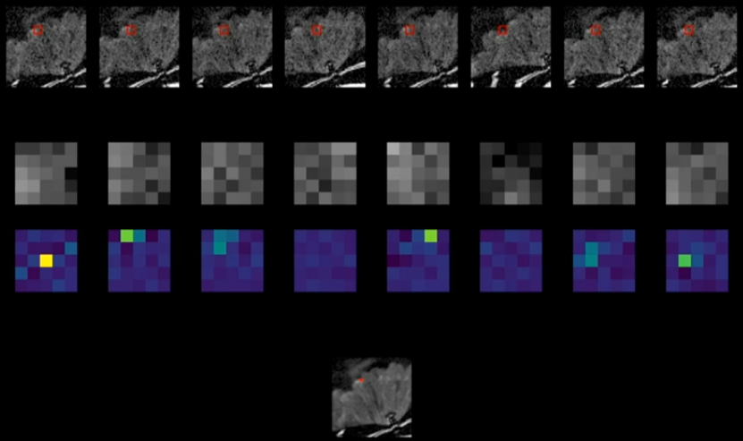
KPN – In details
Final pixel value is calculated. This process repeats for each pixel.
Notes:
Then we just sum all dot products to produce - one – singe – pixel – of the output image. Then just repeat the same process for all pixels in the image and you’re ready to go.

Slide 9
Why so complex?
Interpretability – we can see what happens there.
The kernel predicted for reference image is only denoises.
Notes:
So why so complex? Actually we can understand things by just looking at the produced kernels. For example the kernel for reference image will be always the same – centered pixel with high value.

Slide 10
Why so complex?
Interpretability – we can see what happens there.
The kernel predicted for reference image is only denoise.
Other kernels both align and denoise.
Notes:
Other kernels may be shifted pixels – that’s mean that the patch is shifted relative to reference patch.

Slide 11
Why so complex?
Interpretability – we can see what happens there.
Patches with too much misalignment are set to zero by the kernels.
Notes:
If the shift is too big – the kernel will be practically zero.

Slide 12
How it learns?
As we know, “learning” is basically finding “good enough” local minimum of a loss function.
Basic loss function:
Weighted average of: L2 dist. of images, L1 dist. of gradients.
Г – transformation of RGB values to prevent exploding gradient.
This loss finds a local minima which is not “good enough”.
Notes:
Wow.. Too much math.

Slide 13
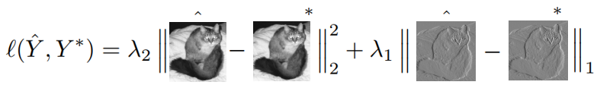
How it learns?
As we know, “learning” is basically finding “good enough” local minimum of a loss function.
Basic loss function:
Weighted average of: L2 dist. of images, L1 dist. of gradients.
Г – transformation of RGB values to prevent exploding gradient.
This loss finds a local minima which is not “good enough”.
Notes:
Ok, it’s better. So the loss function we want to minimize is a weighted sum of:
L2 distance between the ground truth and our result image.
And L1 distance between gradient of ground truth and gradinet of our result.
Unfortunately, a KPN which is trained with this loss tend to look only at reference image and “ignore” other images in the burst.

Slide 14
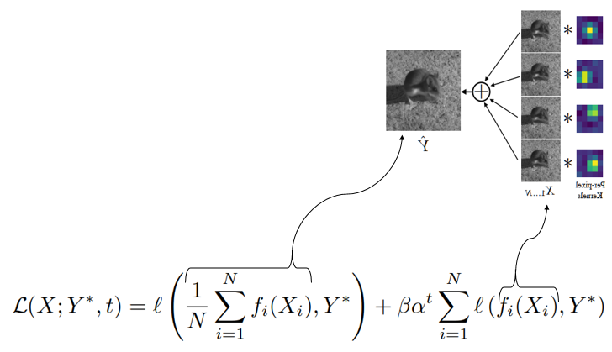
Annealed loss term
As in basic loos function, we want to
minimize the distance between final
result and ground truth.
Also we want to minimize the dist. between
each frame before averaging
and ground truth.
Notes:
Long story short, they ended up with this loss function which changes with time. Here we try to minimize not just the regular loss (from prev. slide) but also a loss of each denoised frame of the burst. The parameter alpha is a positive, less than one number, so as “t” grows (t is actually training epochs), the weight of the right part of the loss function decrease.

Slide 15
Noise level as Network input
In addition to images burst the network take as input the noise level estimation of the burst.
Notes:
One more interesting thing about this architecture – In addition to images they feed the model with noise level estimation of the burst. At first it can seem like cheating, but actually it lets the model to generalize to much higher levels of noise than were used in training phase.

Slide 16
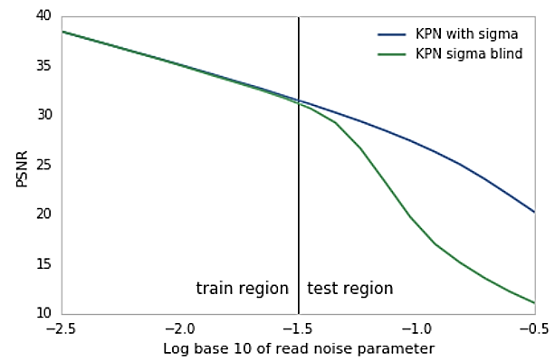
Noise level as Network input
Including the noise estimate lets the network generalize beyond the noise levels on which it was trained.
Good performance with unseen noise levels compared to “blind” network.
Notes:
As we can see from the graph, “blind” model – which didn’t take the noise level as input, has worse performance, while the other has better performance also with noise levels higher than in training phase.

Slide 17
Synthetic training data
Gathering ground truth data for image restoration tasks is challenging.
Burst denoising adds an additional complication.
Because deep neural networks require millions of image patches during training, it is impractical to use real pairs of noisy and noise-free ground truth bursts.
Let’s fake it!
Notes:
You may ask a legit question – where they got all those noisy and noiseless samples of the real world data. Well… they didn’t. It’s practically impossible to create a noisy burst and a noiseless burst of the same scene in real world.

Slide 18
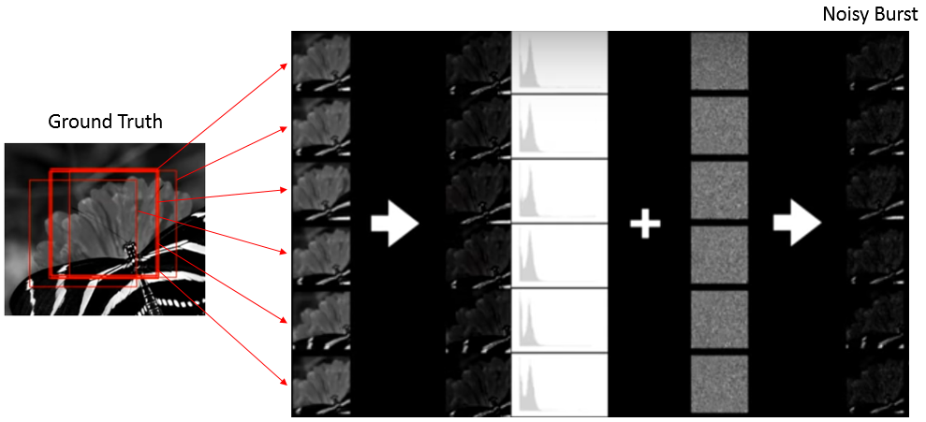
Generating synthetic data
Crop randomly
Scale colors
Add noise.
Notes:
In order to train the model they created a pipeline to convert a “ground truth” image taken from internet to a noisy burst. As you can see here: crop the image randomly to simulate movement, scale it to look like raw data from camera sensor, add noise and here it is – a Noisy burst.

Slide 19
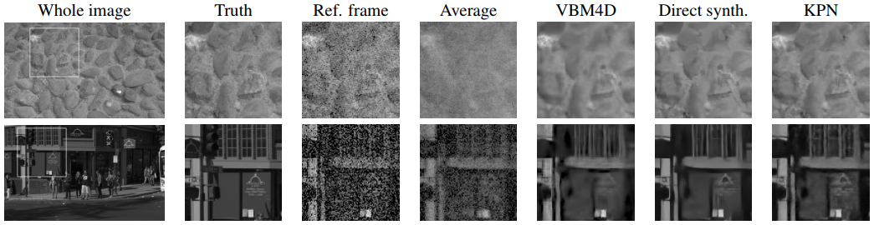
Results
Notes:
Lets see some results. Wow, looks great.

Slide 20
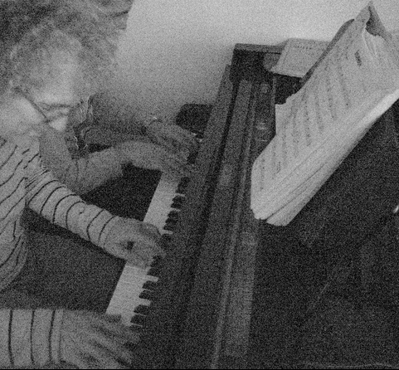
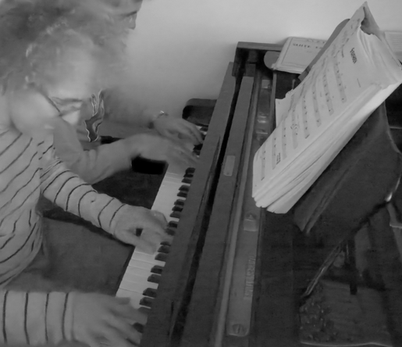
More results
Notes:
Niiice.

Slide 21
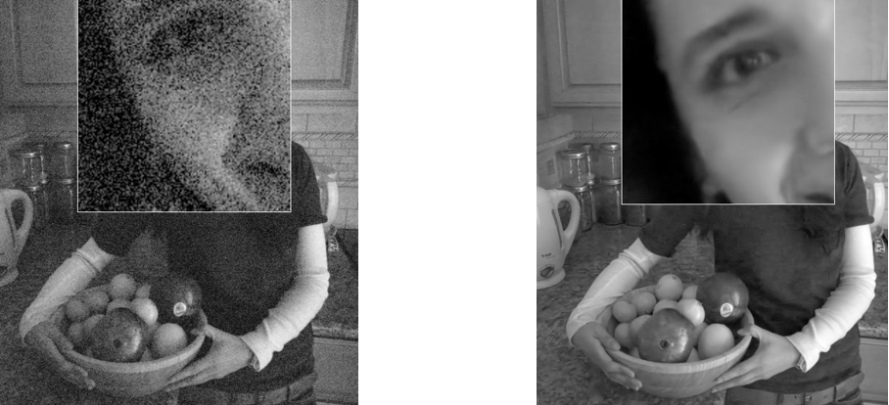
And more results
Notes:
Great!

Slide 22
Papers contributions
A network that outperforms the state of-the-art on synthetic and real data by predicting a denoising kernel
A procedure for converting images taken from the internet into synthetic training data.
A demonstration that a network that takes the noise level of the input imagery as input during training and testing generalizes to a much wider range of noise levels than a blind denoising network
Notes:
So let’s summarize what we saw here. A network which was trained on synthetic data and still outperforms other techniques.
A pipeline to produce synthetic training data.
A demonstrating that if we feed the estimated noise level we achieve better performance.

